Slide 1
Counting sort

Slide 2
Counting Sort
Idea
Counting sort operates by counting the number of objects that have each distinct key value, and using arithmetic on those counts to determine the positions of each key value in the output sequence.
Its running time is linear in the number of items and the difference between the maximum and minimum key values, so it is only suitable for direct use in situations where the variation in keys is not significantly greater than the number of items.

Slide 3
Counting Sort
Example
5 | 12 | 4 | 2 | 4 | 3 | 6 | 4 | 6 | 2 | 9 | 9 | 1 | 9 | 3
Suppose we have this array, let’s calculate count of each element
element | 1 | 2 | 3 | 4 | 5 | 6 | 7 | 8 | 9 | 10 | 11 | 12 | 13 | 14 | 15
count | 1 | 2 | 2 | 3 | 1 | 2 | 0 | 0 | 3 | 0 | 0 | 1 | 0 | 0 | 0

Slide 4
Counting Sort
Example
element | 1 | 2 | 3 | 4 | 5 | 6 | 7 | 8 | 9 | 10 | 11 | 12 | 13 | 14 | 15
count | 1 | 2 | 2 | 3 | 1 | 2 | 0 | 0 | 3 | 0 | 0 | 1 | 0 | 0 | 0
Now let’s place elements from first one back in the array

Slide 5
Counting Sort
Example
element | 1 | 2 | 3 | 4 | 5 | 6 | 7 | 8 | 9 | 10 | 11 | 12 | 13 | 14 | 15
count | 1 | 2 | 2 | 3 | 1 | 2 | 0 | 0 | 3 | 0 | 0 | 1 | 0 | 0 | 0
Now let’s place elements from first one back in the array

Slide 6
Counting Sort
Example
element | 1 | 2 | 3 | 4 | 5 | 6 | 7 | 8 | 9 | 10 | 11 | 12 | 13 | 14 | 15
count | 1 | 2 | 2 | 3 | 1 | 2 | 0 | 0 | 3 | 0 | 0 | 1 | 0 | 0 | 0
Now let’s place elements from first one back in the array
1

Slide 7
Counting Sort
Example
element | 1 | 2 | 3 | 4 | 5 | 6 | 7 | 8 | 9 | 10 | 11 | 12 | 13 | 14 | 15
count | 0 | 2 | 2 | 3 | 1 | 2 | 0 | 0 | 3 | 0 | 0 | 1 | 0 | 0 | 0
Now let’s place elements from first one back in the array
1 | 2 | 2

Slide 8
Counting Sort
Example
element | 1 | 2 | 3 | 4 | 5 | 6 | 7 | 8 | 9 | 10 | 11 | 12 | 13 | 14 | 15
count | 0 | 0 | 2 | 3 | 1 | 2 | 0 | 0 | 3 | 0 | 0 | 1 | 0 | 0 | 0
Now let’s place elements from first one back in the array
1 | 2 | 2 | 3 | 3

Slide 9
Counting Sort
Example
element | 1 | 2 | 3 | 4 | 5 | 6 | 7 | 8 | 9 | 10 | 11 | 12 | 13 | 14 | 15
count | 0 | 0 | 0 | 3 | 1 | 2 | 0 | 0 | 3 | 0 | 0 | 1 | 0 | 0 | 0
Now let’s place elements from first one back in the array
1 | 2 | 2 | 3 | 3 | 4 | 4 | 4

Slide 10
Counting Sort
Example
element | 1 | 2 | 3 | 4 | 5 | 6 | 7 | 8 | 9 | 10 | 11 | 12 | 13 | 14 | 15
count | 0 | 0 | 0 | 0 | 1 | 2 | 0 | 0 | 3 | 0 | 0 | 1 | 0 | 0 | 0
Now let’s place elements from first one back in the array
1 | 2 | 2 | 3 | 3 | 4 | 4 | 4 | 5

Slide 11
Counting Sort
Example
element | 1 | 2 | 3 | 4 | 5 | 6 | 7 | 8 | 9 | 10 | 11 | 12 | 13 | 14 | 15
count | 0 | 0 | 0 | 0 | 0 | 2 | 0 | 0 | 3 | 0 | 0 | 1 | 0 | 0 | 0
Now let’s place elements from first one back in the array
1 | 2 | 2 | 3 | 3 | 4 | 4 | 4 | 5 | 6 | 6

Slide 12
Counting Sort
Example
element | 1 | 2 | 3 | 4 | 5 | 6 | 7 | 8 | 9 | 10 | 11 | 12 | 13 | 14 | 15
count | 0 | 0 | 0 | 0 | 0 | 0 | 0 | 0 | 3 | 0 | 0 | 1 | 0 | 0 | 0
Now let’s place elements from first one back in the array
1 | 2 | 2 | 3 | 3 | 4 | 4 | 4 | 5 | 6 | 6 | 9 | 9 | 9

Slide 13
Counting Sort
Example
element | 1 | 2 | 3 | 4 | 5 | 6 | 7 | 8 | 9 | 10 | 11 | 12 | 13 | 14 | 15
count | 0 | 0 | 0 | 0 | 0 | 0 | 0 | 0 | 0 | 0 | 0 | 1 | 0 | 0 | 0
Now let’s place elements from first one back in the array
1 | 2 | 2 | 3 | 3 | 4 | 4 | 4 | 5 | 6 | 6 | 9 | 9 | 9 | 12

Slide 14
Counting Sort
Example
element | 1 | 2 | 3 | 4 | 5 | 6 | 7 | 8 | 9 | 10 | 11 | 12 | 13 | 14 | 15
count | 0 | 0 | 0 | 0 | 0 | 0 | 0 | 0 | 0 | 0 | 0 | 0 | 0 | 0 | 0
Array is sorted.
1 | 2 | 2 | 3 | 3 | 4 | 4 | 4 | 5 | 6 | 6 | 9 | 9 | 9 | 12

Slide 15
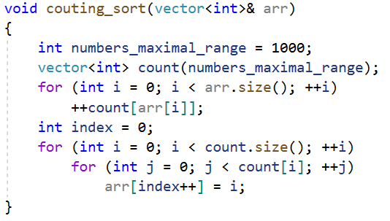
Counting Sort
Implementation

Slide 16
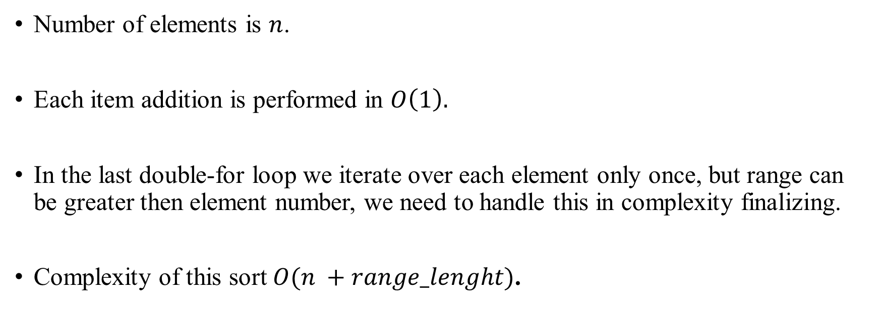
Counting Sort
Analysis

